Slide 1

Superstore Sales Analysis Presentation
By Nourhan Kazem, Mohamed Abdel Menaeim & Virginia Tawfik

Slide 2
Project analysis slide 2
Agenda
Analysis Objective
Preprocessing Data
Forecasting with python
PROJECT
Descriptive analysis
Tableau dashboard
Python charts
Insights & recommendations

Slide 3

Project analysis slide 3
Analysis objective
Superstore Data Analysis project dives into sales & profit patterns according to geographical distribution, product performance and customer behavior providing insights that inform decision makers with strategic outcomes to achieve continued success and refinement of the Superstore.
The analysis aims to uncover trends and preferences in the data to aid different company departments achieve increasing Profit and targeting the right audience.

Slide 4




Project analysis slide 3
Dashboard content
Overview
Sales Analysis
Profit Analysis
Discounts & Trends
General Overview about Sales/Quantity/Profit trends over time and their distributions by Region and states.
Sales insights and distributions by customer segments and product categories. Could be directed to stakeholders
Profit insights and distributions by customer segments and product categories. Is also directed to stakeholders, side by side with the sales outcomes.
Deeper look into customer behavior and discount correlation with sales and profit .
Is mainly directed to the marketing team that will surely use it for their campaigns to wide our market penetration.

Slide 5

1.Preprocessing Data

Slide 6
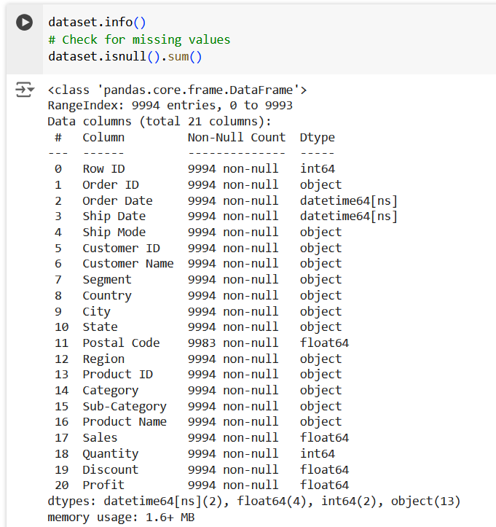
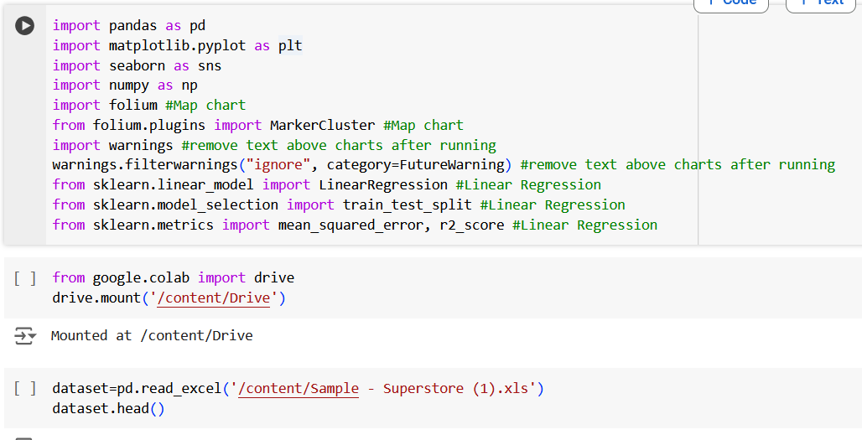
Installing Pandas, Matplotlib and other libraries that we used. Extracting Data from CSV file on drive using Python.
Checking missing values

Slide 7
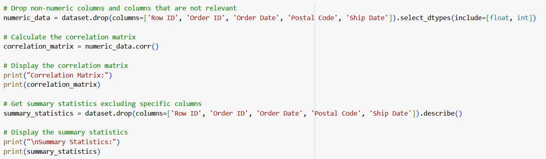
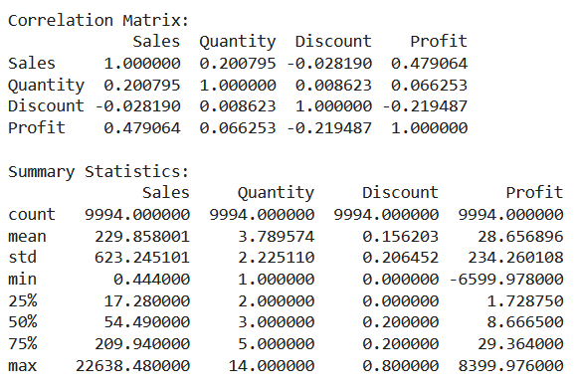
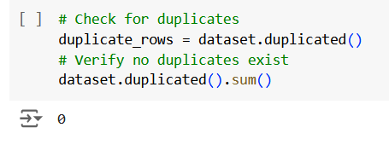
Keeping on important columns for our summary statistics and excluding the non-numeric columns
Calculating Correlation Matrix between numerical columns
Checking for duplicates (0 found)

Slide 8
2. Descriptive analysis

Slide 9
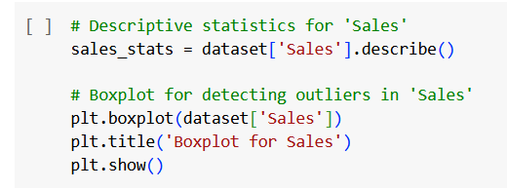
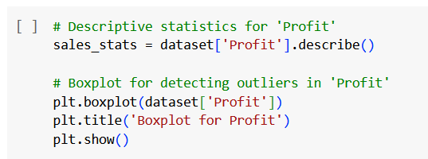
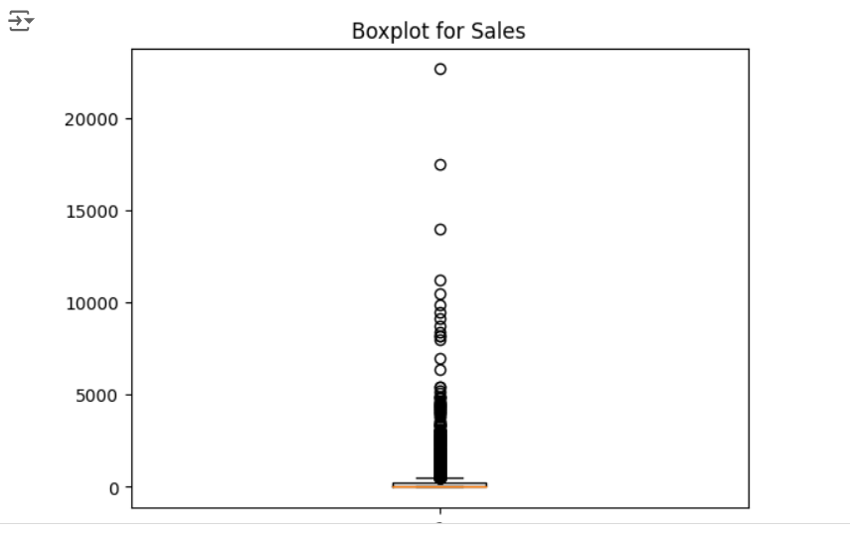
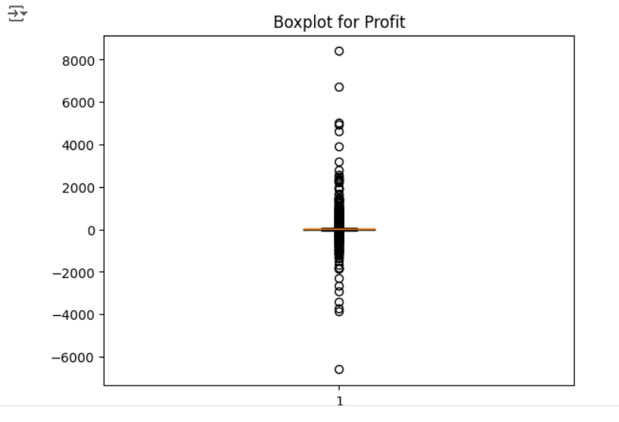
Sales boxplot
Profit boxplot

Slide 10
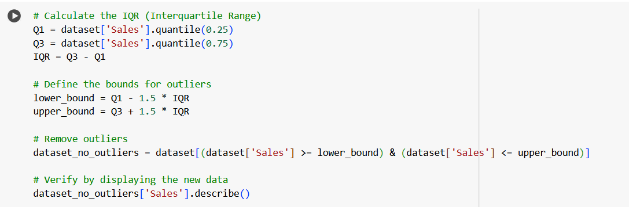
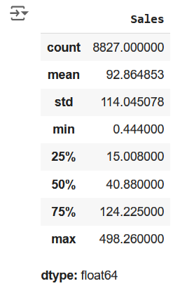
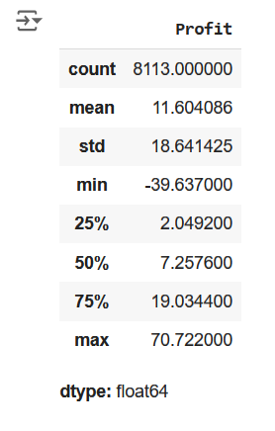
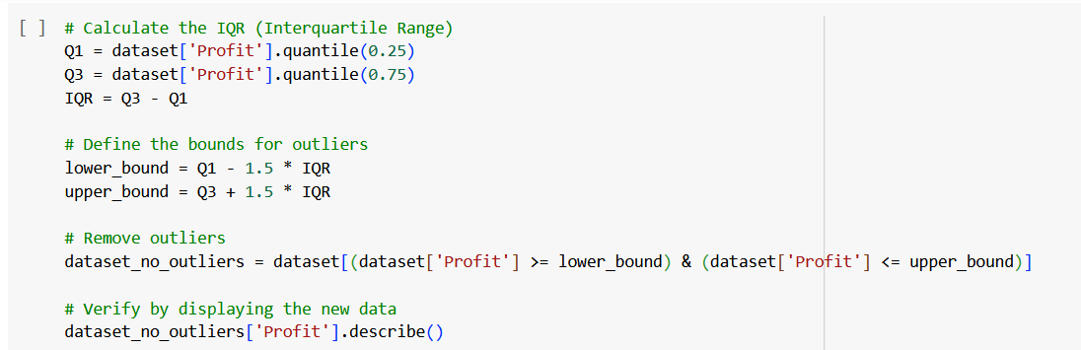
summary statistics of Sales and Profit data showing central tendencies and spread measures.
#Side note: no Outliers were found. Number of rows stayed the same after cleaning.

Slide 11
3. Python charts & analysis

Slide 12
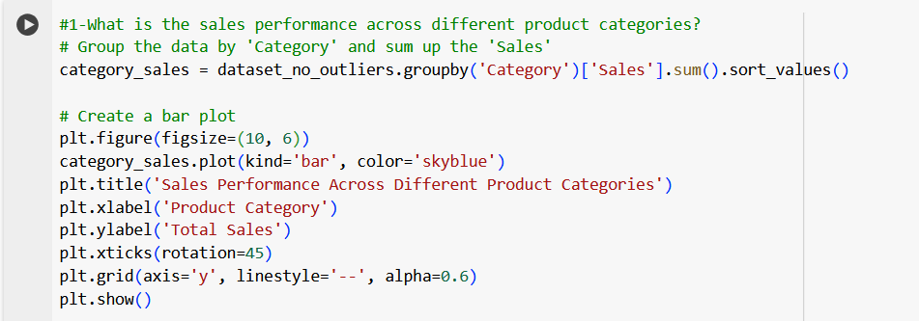
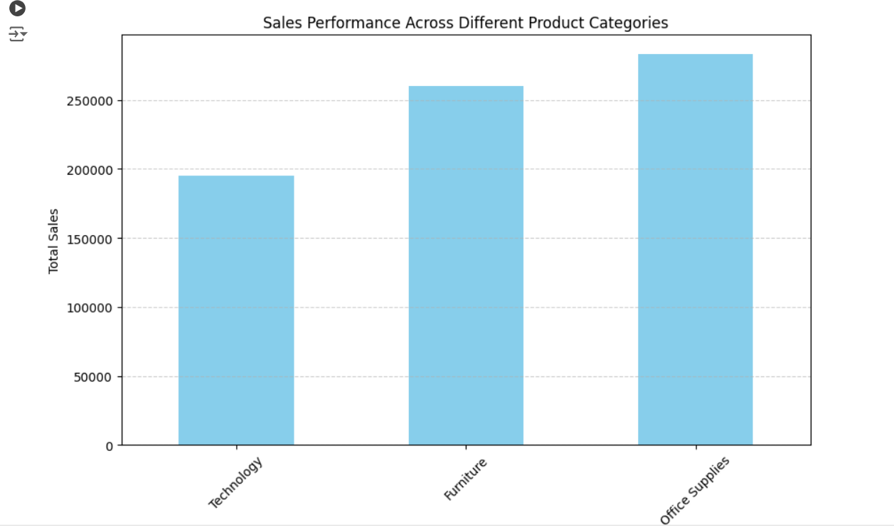
1. Sales Performance by different product categories
grouping the data by Category and summing the Sales, we’re identifying which product categories are generating the highest and lowest revenue.

Slide 13
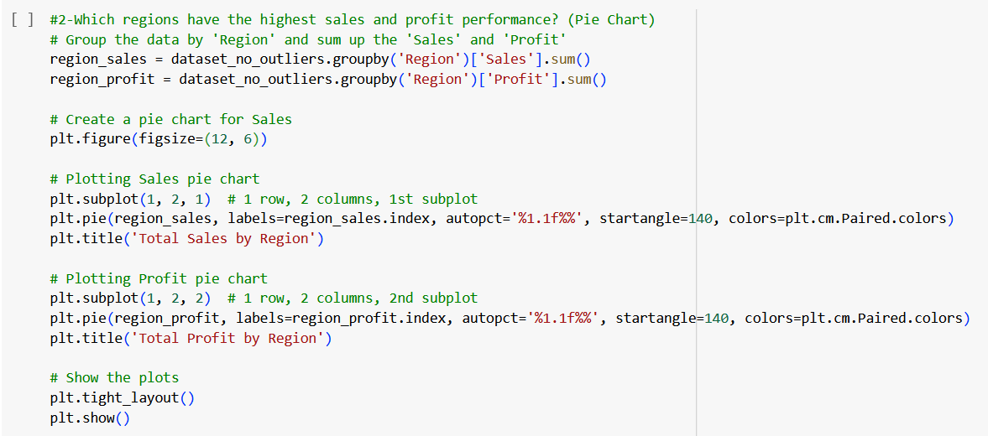
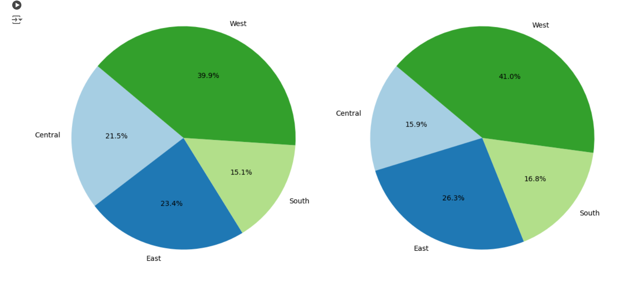
2. Portion of Sales and Profit by region
Used the matplotlib to
visualize 2 pie charts
.. the pie charts give us a clear visual breakdown of the sales share and profit share contributed by each region.

Slide 14
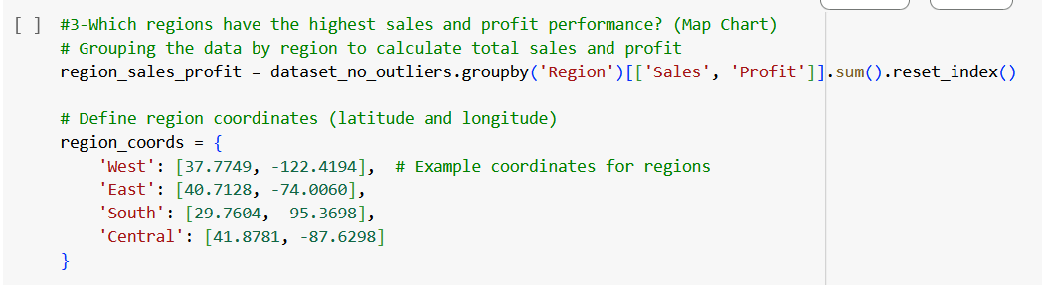
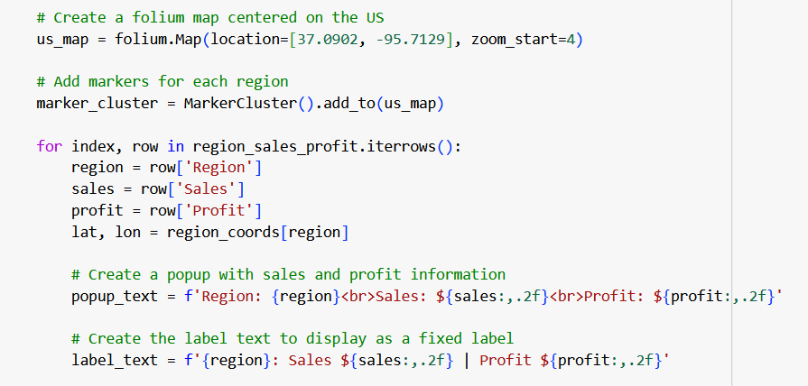
3. Map showing Sales and Profit per region (1)
Used the folium Library to visualize the USA map
Defined each Region
Adding labels and Popup
showing sales and profit
values for each Region

Slide 15
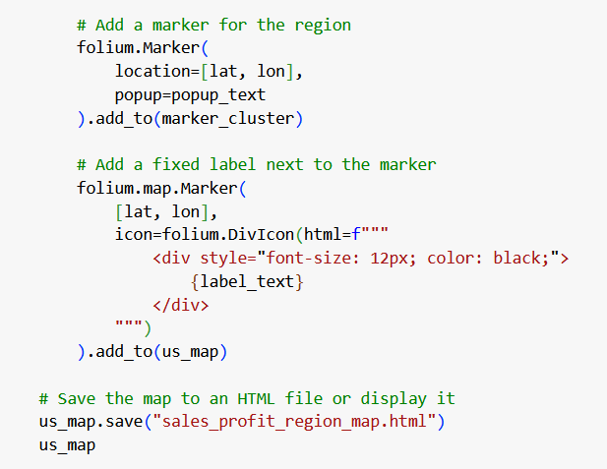
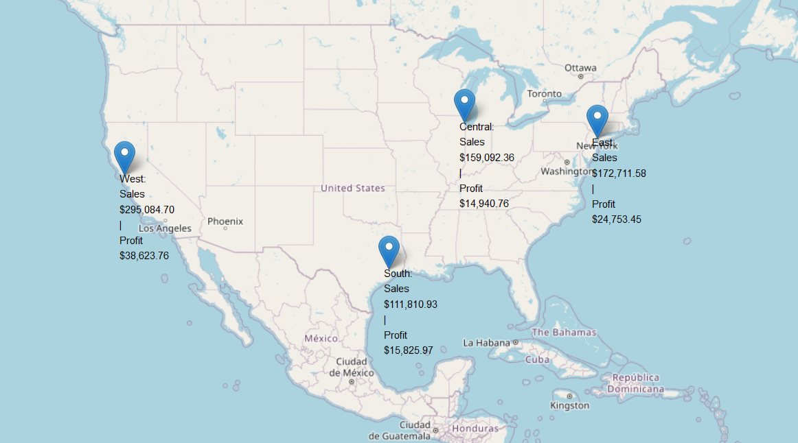
3. Map showing Sales and Profit per region (2)
>> Geographical Overview, The map provides a clear geographical overview of how different regions (e.g., West, East, South, Central) perform in terms of total sales and profit. Each region is marked on the map with a popup displaying sales and profit figures.

Slide 16
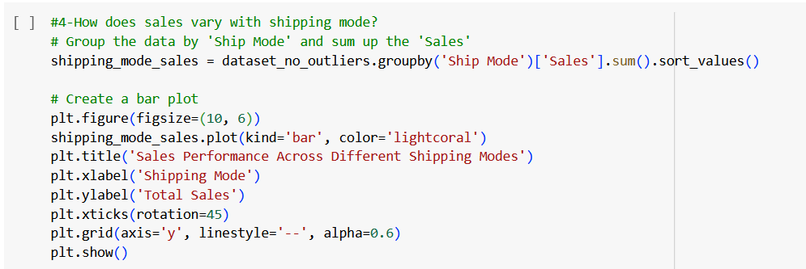
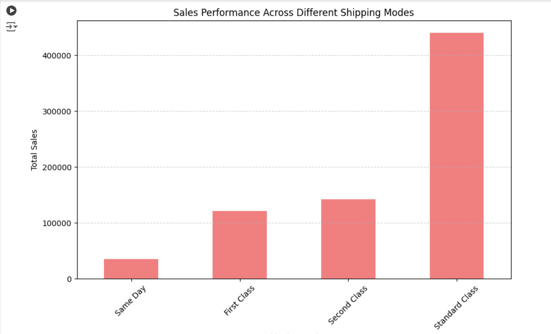
The bar plot visually compares the total sales for each shipping mode
4. Sales Performance by ship modes

Slide 17
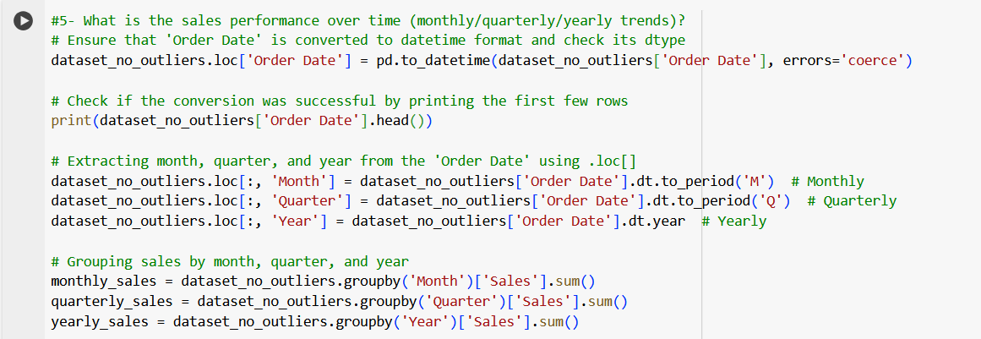
5. Sales Trends
grouping sales data into monthly, quarterly, and yearly trends

Slide 18
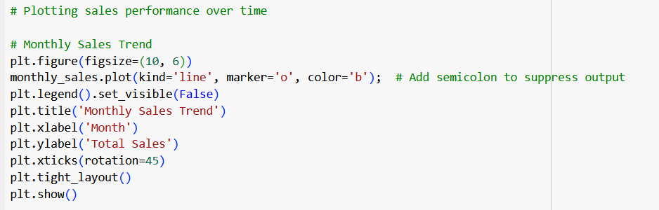
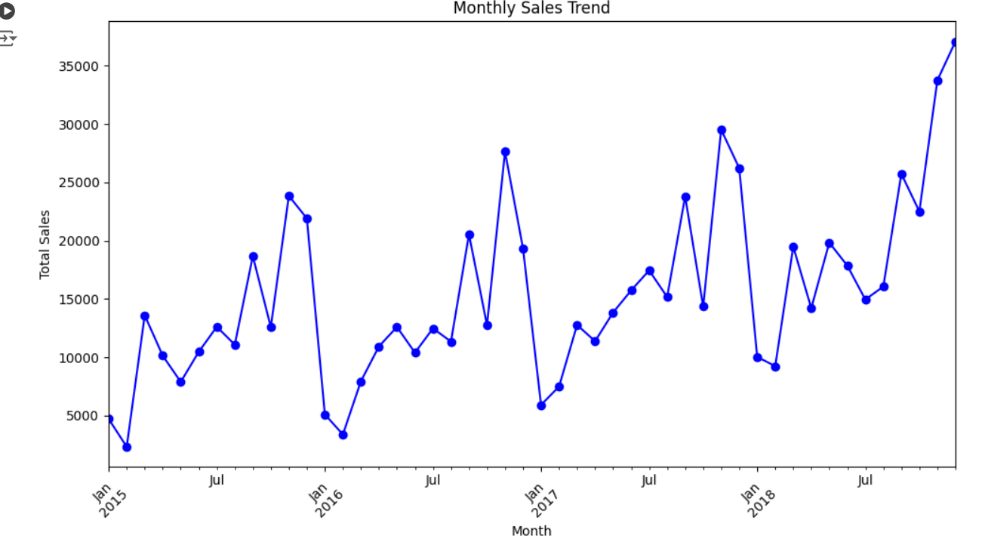
>> Sales Trends over Months ..
The data can highlight peak months where sales are significantly higher.

Slide 19
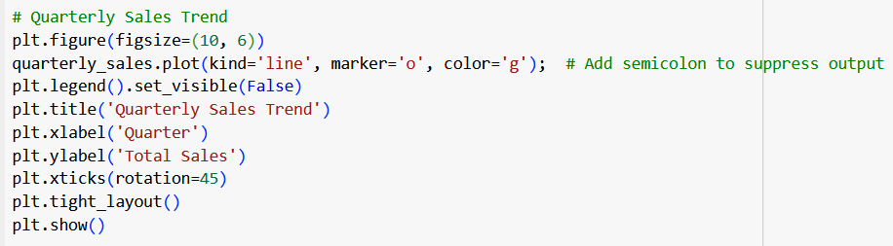
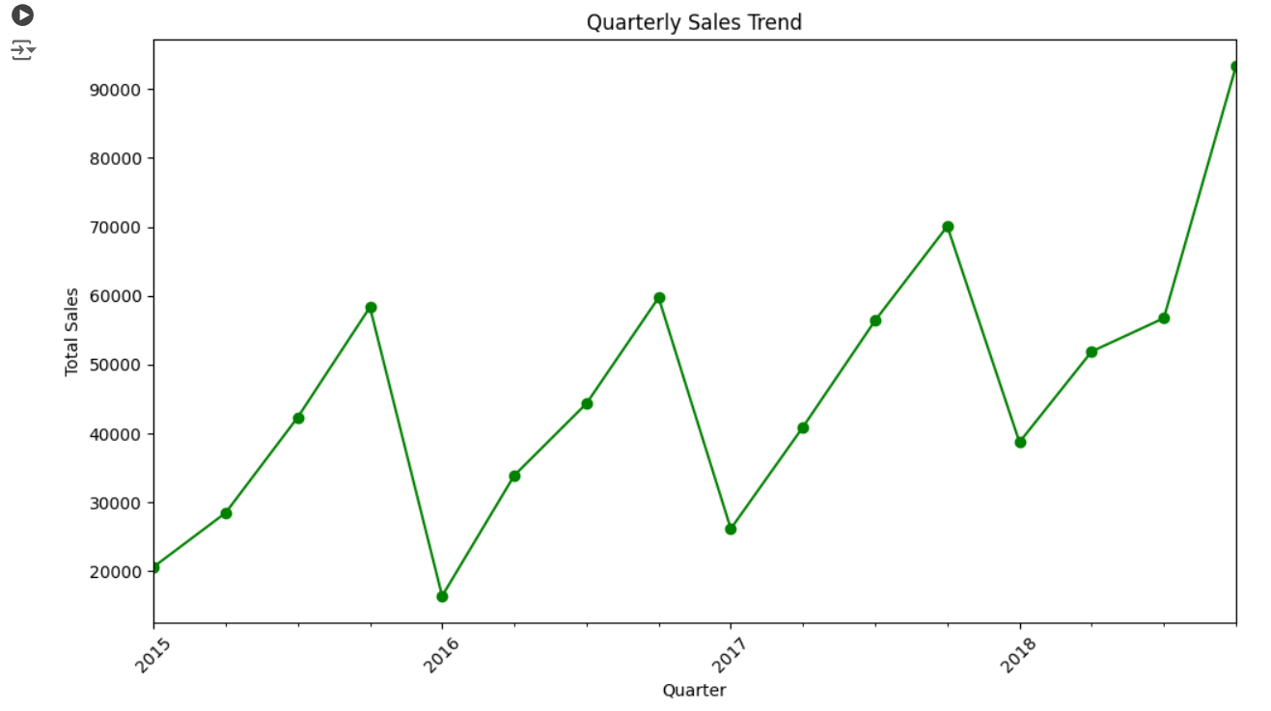
>> Sales Trends over Quarters ..
Grouping by quarter helps smooth out the monthly fluctuations and offers a broader perspective on business performance.

Slide 20
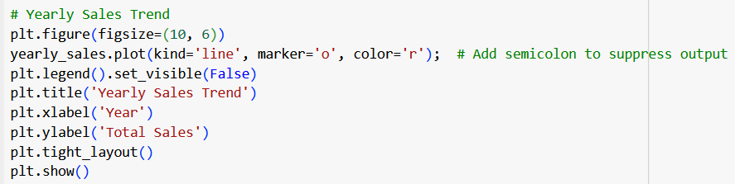
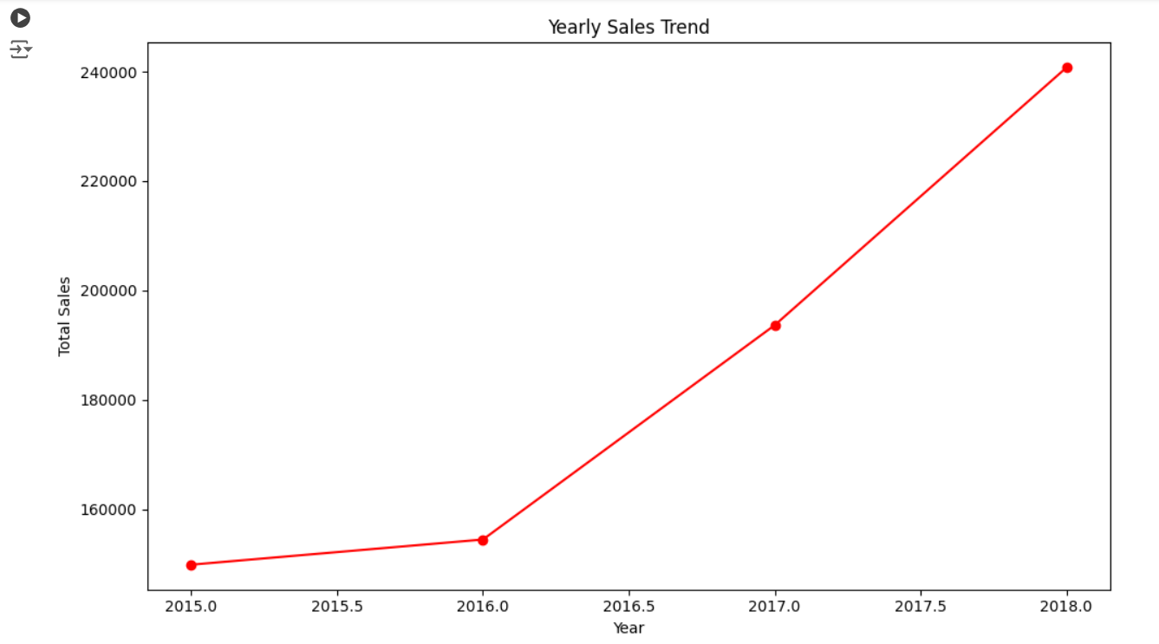
>> Sales Trends over Years ..
Yearly sales trends provide a macro-level view of your business growth over time

Slide 21
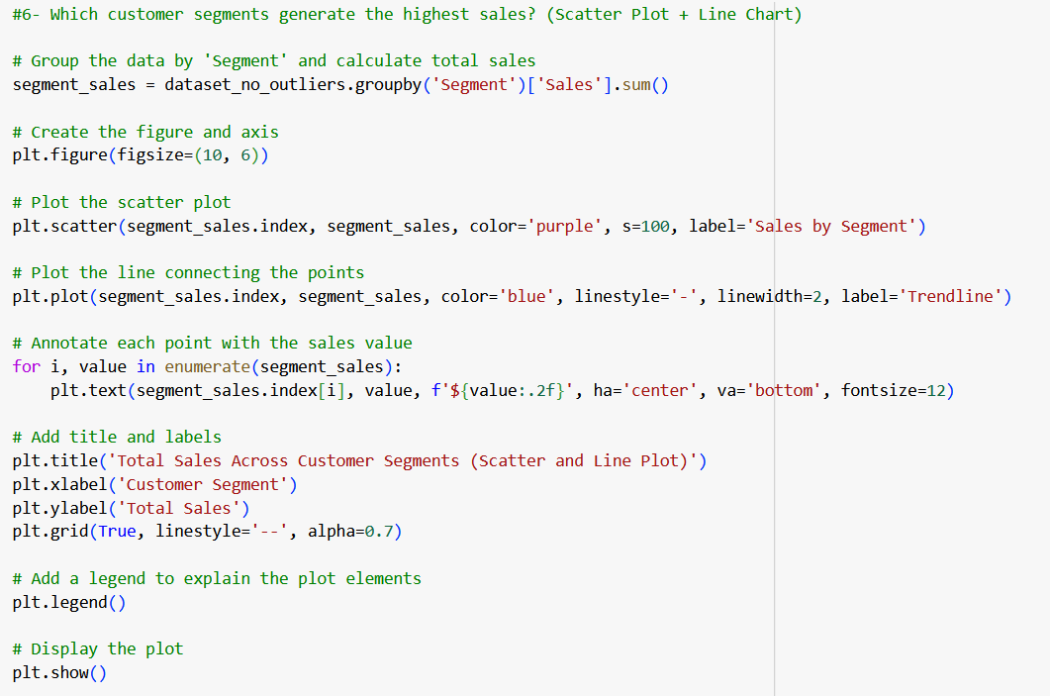
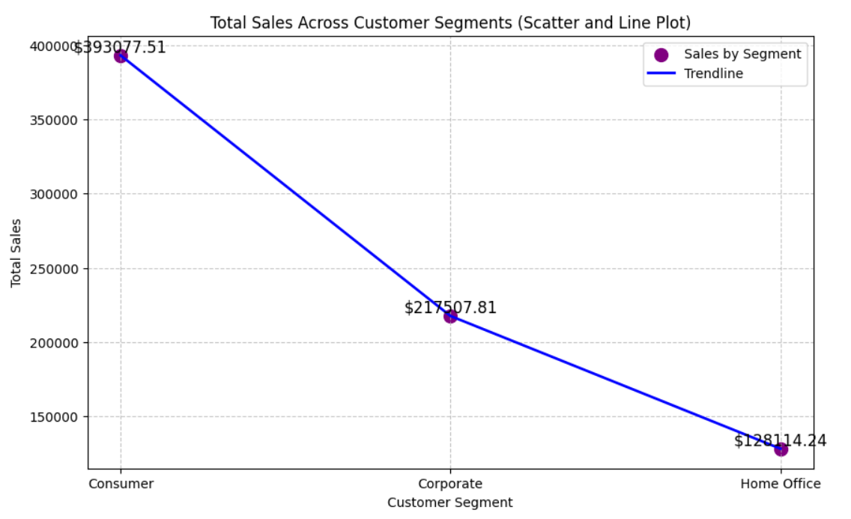
6. Sales by Customer Segments
Scatter Plot: Plots the individual customer segments with scatter points.
Line Plot: Connects the scatter points with a line to highlight the trend of total sales across segments.

Slide 22
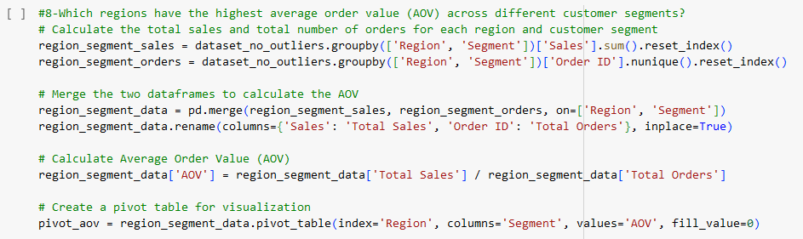
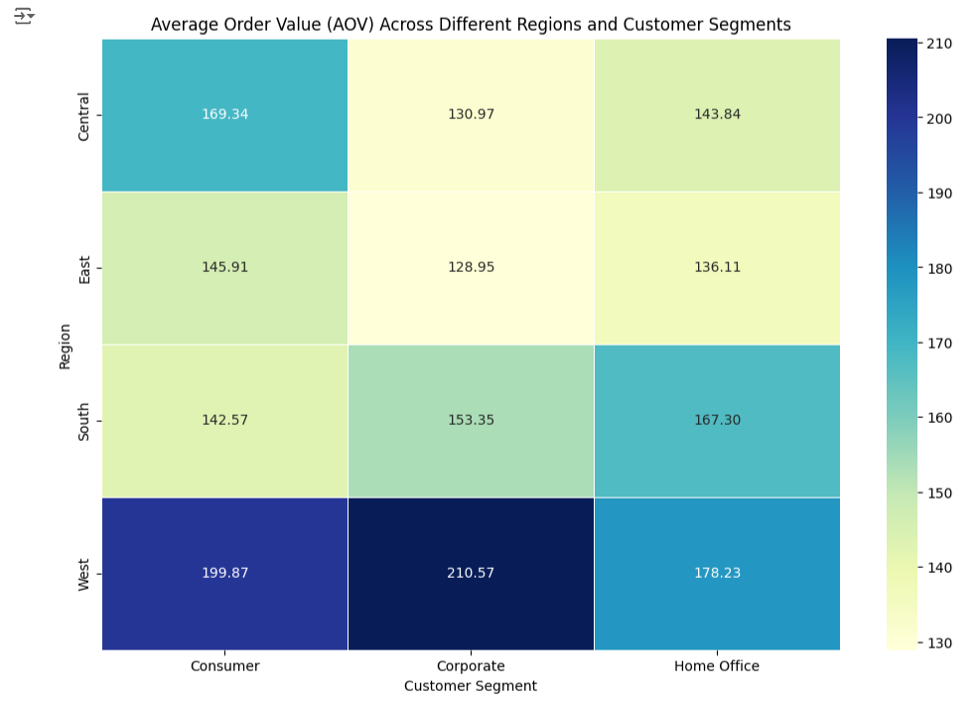
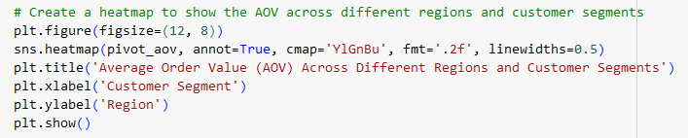
7. Highest AOV across customer segments by regions (1)
The heatmap highlights the regions with the highest AOVs for different customer segments, allowing you to easily compare which regions have the most valuable orders.

Slide 23
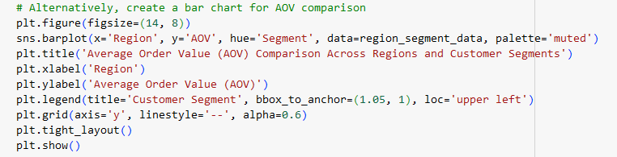
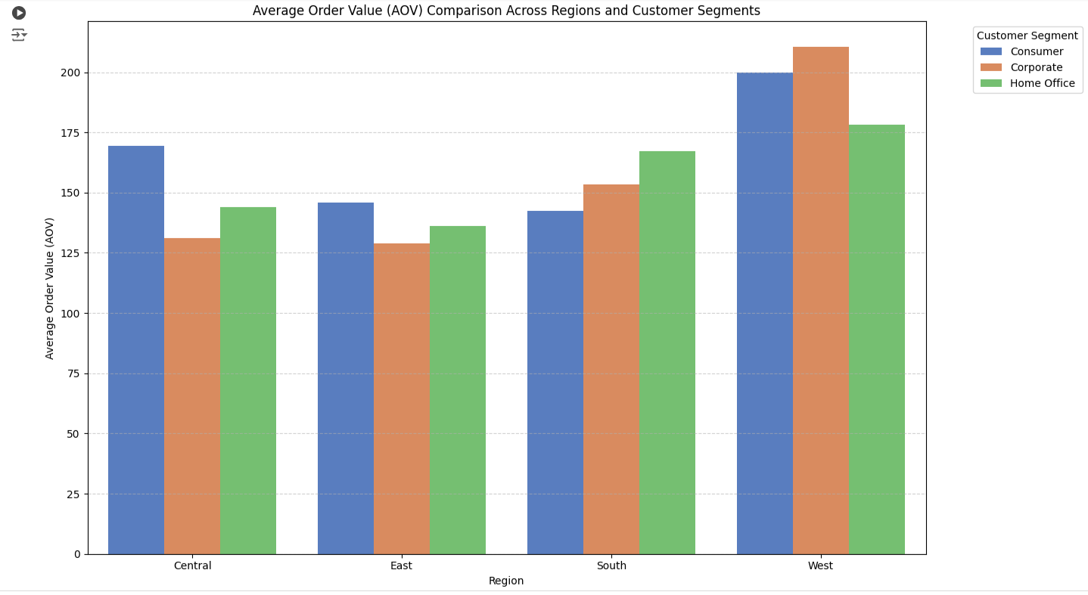
7. Highest AOV across customer segments by regions (2)
The comparison of AOV across different customer segments (e.g., Corporate, Consumer, Home Office) helps identify which segments are contributing to the high AOV in each region.

Slide 24
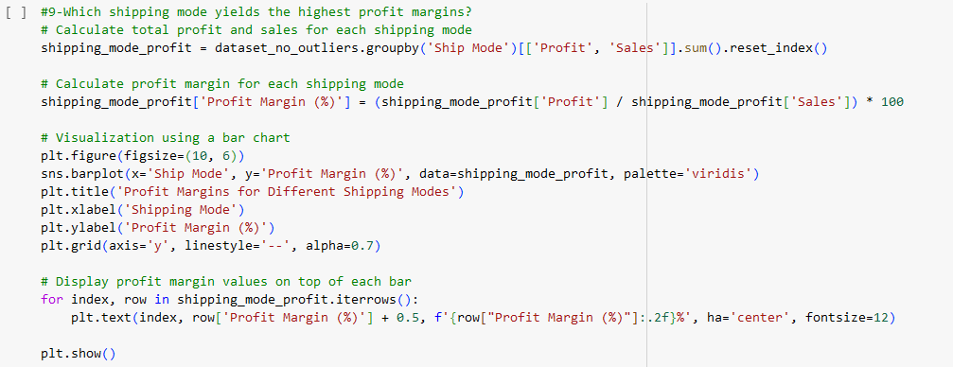
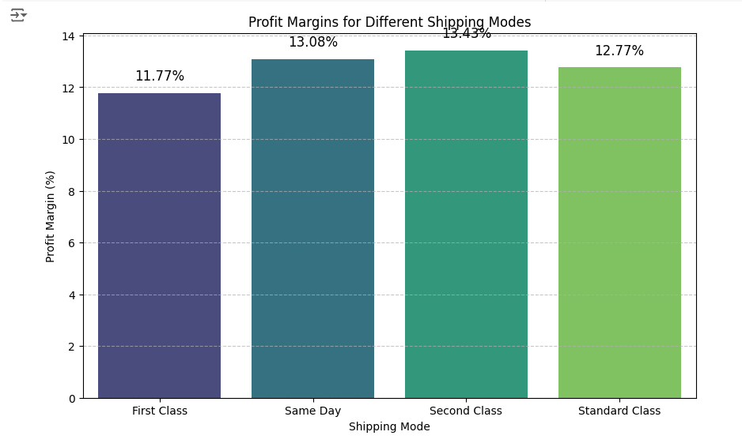
8. Profit margin per Shipping Mode
The analysis of profit margins across different shipping modes provides critical insight into which modes contribute most efficiently to the bottom line

Slide 25
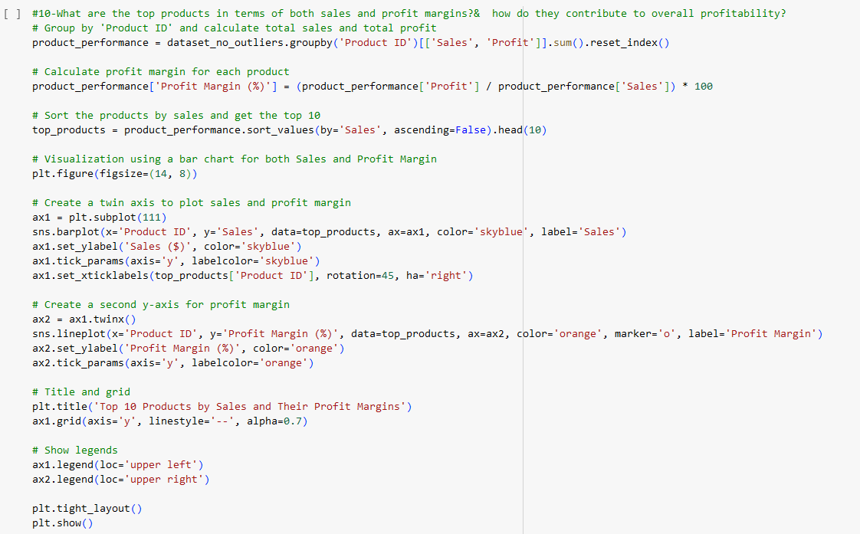
9. Top Products by sales and profit margins (code)
This code aims to identify the top 10 products by sales and analyze their corresponding profit margins. It then visualizes both sales and profit margin using a bar chart and line plot.

Slide 26
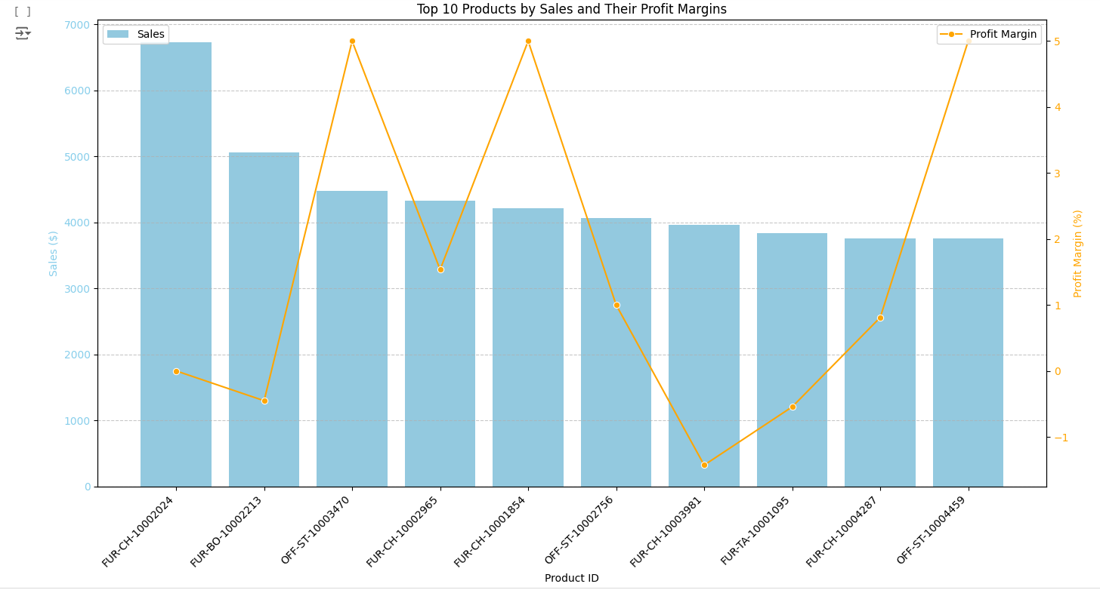
9. Top Products by sales and profit margins (chart)
These products are the best performers in terms of total sales, indicating they are the most popular or frequently purchased by customers.
The bar chart shows the total sales for each of the top 10 products. Taller bars represent higher sales, showing which products contribute the most to overall revenue.

Slide 27
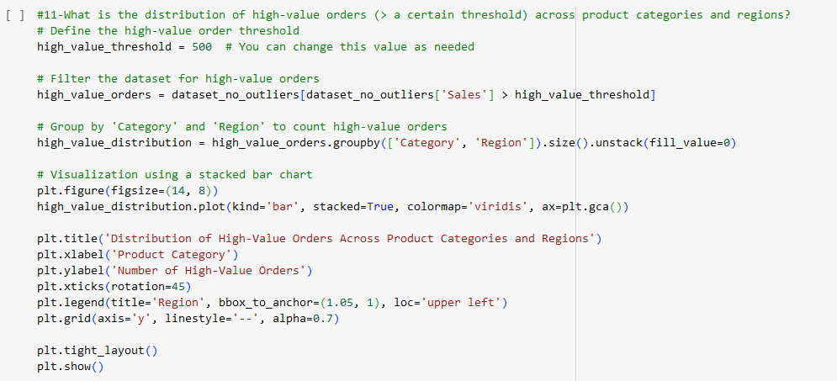
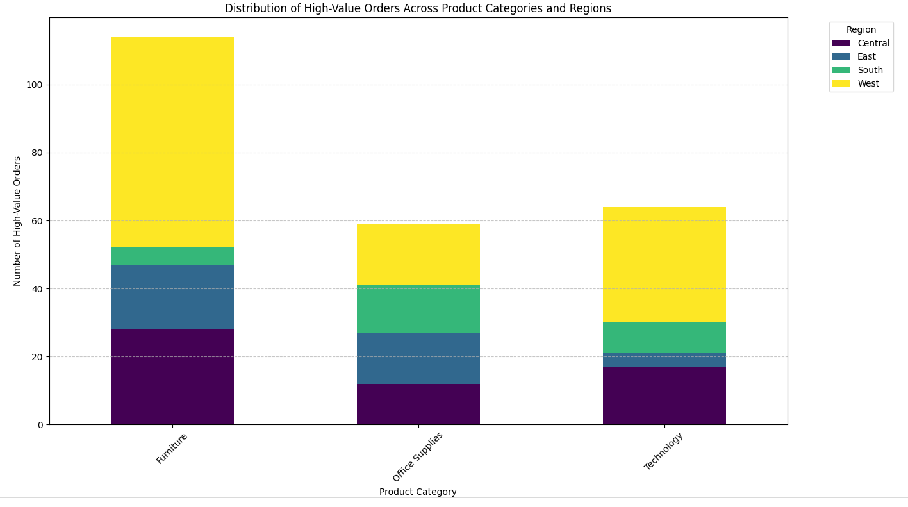
10. High Value orders across product categories and regions (stacked bar chart)
The provided code analyzes and visualizes the distribution of high-value orders (defined as orders exceeding a specified threshold=500) across different product categories and regions.

Slide 28
4. Forecasting with python

Slide 29
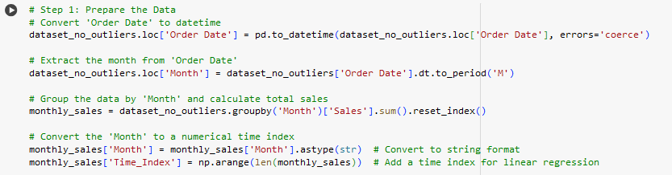
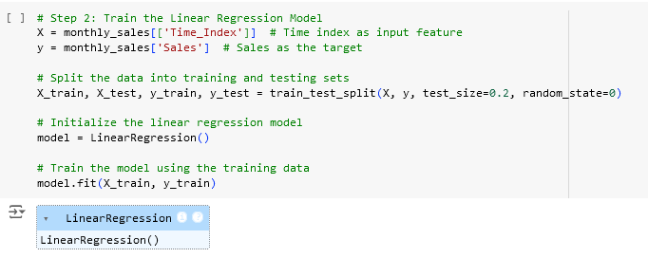
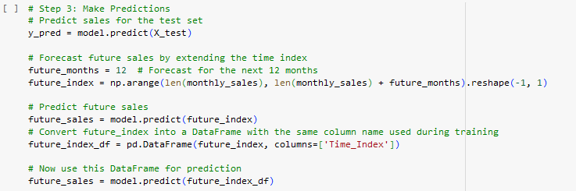
Step 1: Prepare the data
Step 2: Train the Linear Regression Model
Step 3: Make Predictions

Slide 30
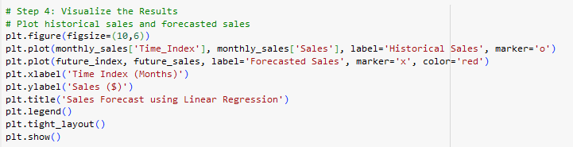
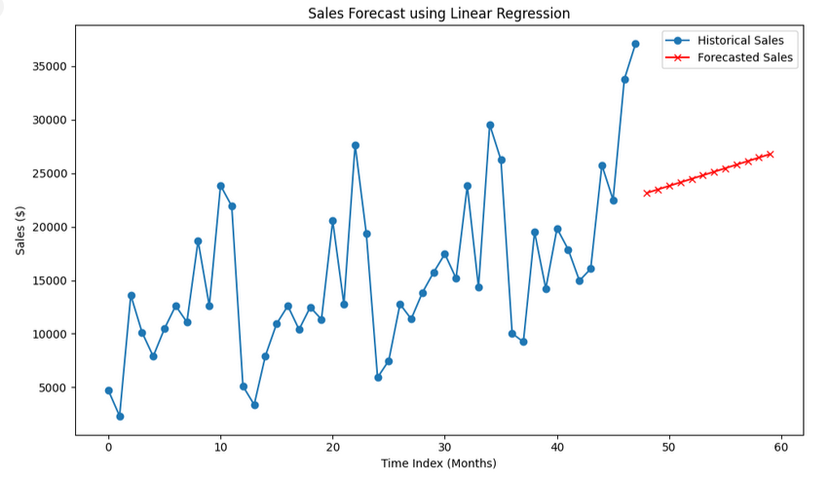
Step 4: Visualization
And finally saving the file :)

Slide 31

Forecasting Insights
Sales Trends Analysis (Historical Data):
The historical sales data, plotted against the time index, reveals the overall trend of sales over the past months.
The trend line is upward, it indicates growing demand and improving sales.
Future Sales Forecasting (Next 12 Months):
Based on the forecasted sales, the model predicts an increase in future sales over the next 12 months, it suggests growth opportunities. This could guide business decisions such as ramping up production, increasing inventory, or expanding marketing efforts.

Slide 32
5. Tableau dashboard

Slide 33
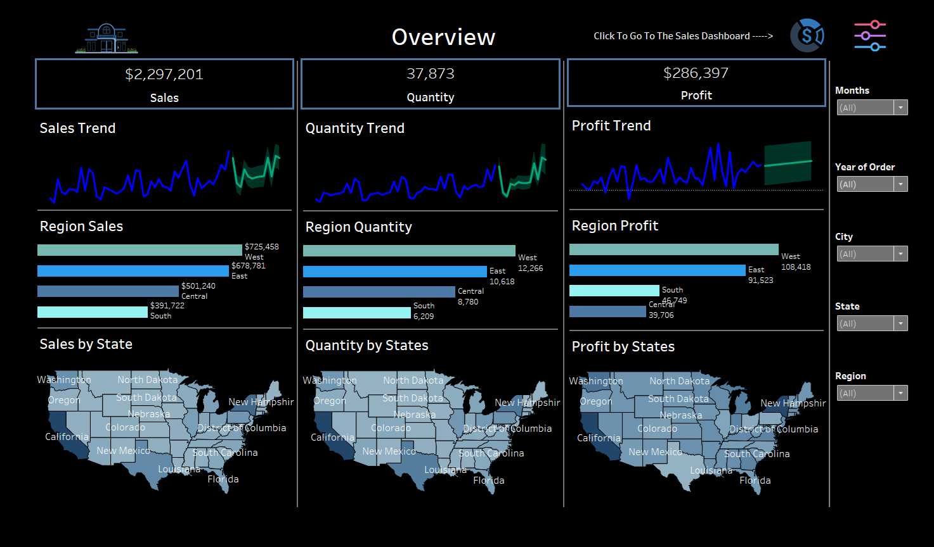

Slide 34
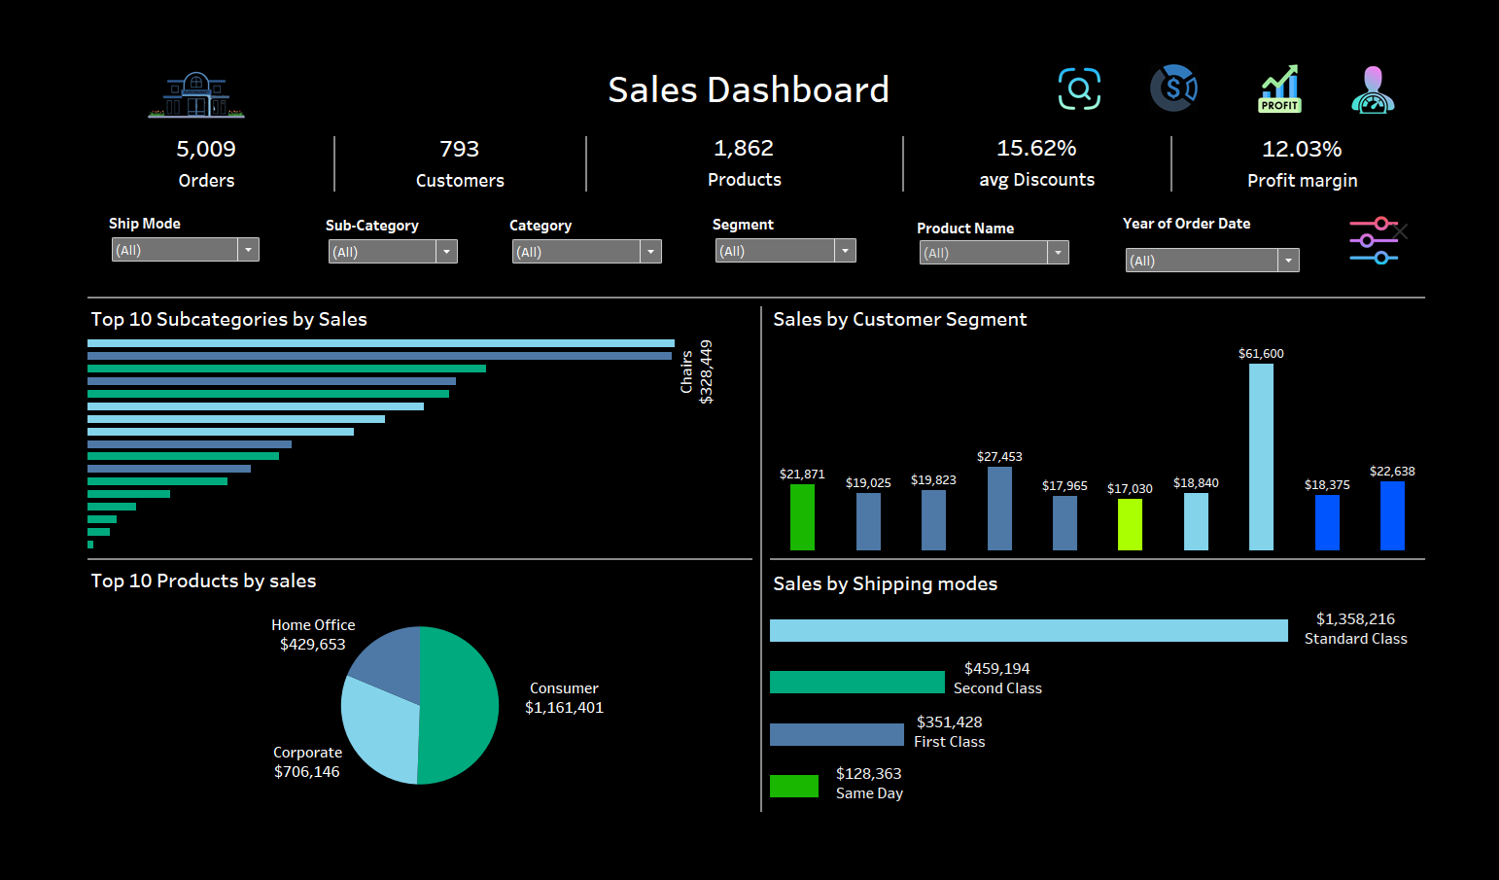

Slide 35


Slide 36


Slide 37
6. Insights & Recommendations

Slide 38
Project analysis slide 5
Overview:
1. Total Sales, Quantity, and Profit:
These values give an overall snapshot of the business's performance in terms of revenue, product quantity sold, and profitability.
2. Trends (Sales, Quantity, and Profit):
The sales trend, quantity trend, and profit trend show some fluctuations but with a positive direction towards the end. This indicates that business performance has been improving recently.
3. Regional Performance:
Sales: West is the highest-performing region, with $725,458 in sales. East follows closely with $678,781 in sales. Central and South regions are behind with $501,240 and $391,722, respectively.
Quantity: West leads in quantity sold (12,266 units), followed by the East (10,618 units). The Central (8,780 units) and South (6,209 units) regions have the lowest quantity.
Profit: The West region leads in profitability with $108,418 in profit. The East region is close behind at $91,523. Central and South regions have profits of $65,749 and $39,706, respectively.

Slide 39
Project analysis slide 5
4. State-Level Performance:
Some of the highest sales seem concentrated in states like California, Washington, and the northeastern regions. Quantity and Profit by State reflects a similar pattern as sales.
5. West and East regions dominate both in sales and profit, indicating these areas are the most lucrative.
There might be room for improvement in the Central and South regions, where sales and profit are comparatively lower.
The positive trends in sales, quantity, and profit suggest that the business is growing, and efforts should focus on sustaining this growth.
Recommendations:
Explore strategies to improve performance in the Central and South regions, where sales and profit are lower.

Slide 40
Project analysis slide 11
Sales insights:
1. Top Subcategories by Sales:
The top three subcategories are : Phones: $330,007 - Chairs: $328,449 - Storage: $223,844
These high-performing subcategories dominate in sales, with phones and chairs being the biggest contributors. There is a steep drop in sales after these top two categories, indicating that Phones and Chairs may be the focal products for the business.
2. Top 10 Selling Products:
The product generating the most revenue is listed at $61,600 (Canon Image Copier), followed by a significant drop for the next highest product, which contributes $21,871 (Fellowes PB500).
3. Sales by Customer Segment:
The consumer segment ($1,161,401) leads by a significant margin, followed by corporate ($706,146). This suggests that most of the sales volume comes from individual customers, with business customers also making up a large portion.
4. Sales by Shipping Mode:
Standard shipping is the preferred shipping mode, accounting for most sales. This indicates customers prioritize cost savings over faster shipping. Same-day shipping makes up a small portion, indicating that speed is not a key concern for most buyers.

Slide 41
Project analysis slide 11
Business Insights:
The business is heavily reliant on a few subcategories, specifically Phones and Chairs, and one top-selling product. Diversification of products should be considered to reduce the risk of relying too much on these categories.
The consumer segment dominates sales. Focusing on strategies to expand the corporate and home office segments could further diversify revenue streams.
Standard Class is the most popular shipping mode. While this suggests that customers value cost savings over speed, there may be an opportunity to encourage more premium shipping options through targeted promotions or loyalty programs.
Recommendations:
Product Diversification: While Phones and Chairs are driving revenue, the business should explore ways to promote other subcategories to reduce dependency on a few product lines.
Improve Corporate Sales: Since corporate clients represent a smaller portion of sales, consider tailored marketing campaigns or special offers aimed at business customers to drive growth in this segment.
Shipping Upsell Strategies: Develop incentives for faster shipping options like First Class or Same Day, especially for high-value customers or during peak seasons, to increase revenue from these more expensive shipping methods.

Slide 42
Project analysis slide 11
Profit insights:
1. Top Subcategories by Profit:
Copiers, Phones, and Paper are the most profitable subcategories and should remain a focus. However, Tables are a major issue in terms of profitability, and it’s crucial to reassess their cost structure, pricing, or demand.
2. Top 10 Profitable Products:
The most profitable product has generated $25,200 in profit.
Other products range from $7,753 to $6,984, with the bottom-performing products generating losses. The least profitable product incurs a loss of - $1,811.
3. Sales by Customer Segment:
The consumer segment ($134,119 in profit) is the most profitable customer segment, contributing more than the other segments combined (Corporate Segment: $91,979 - Home Office Segment: $60,299)
4. Sales by Shipping Mode:
Standard class shipping is the most profitable, contributing substantially more than other shipping modes. Same day shipping, while less popular, still provides profit.

Slide 43
Project analysis slide 11
Business Insights:
The business relies heavily on certain products (e.g., copiers, phones) for profitability, while some products and subcategories (e.g., tables, bookcases) are causing significant losses.
The consumer segment is the most lucrative. However, the corporate and home office segments also show good potential.
Standard Class is not only the most popular but also the most profitable shipping mode.
Recommendations:
Product review: For Tables, Bookcases, and other loss-making items, perform an in-depth analysis to see whether they can be restructured (e.g., cost reductions, improved pricing). Consider discontinuing or limiting focus on unprofitable products.
Since Copiers, Phones, and Paper are performing well, the business should continue to focus on promoting these categories. Additionally, ensure inventory and supply chain processes are optimized for these high-profit categories.
Increase Corporate and Home Office Focus: Since these segments show profitability potential, tailored marketing efforts or business-specific packages could help increase revenue and profit from these segments.
Shipping Strategies: Given that Standard Class is dominant, the business might experiment with promotions or loyalty incentives to encourage First Class or Same Day shipping, which could improve overall profitability on select high-margin products.

Slide 44
Project analysis slide 11
Discounts & Trends insights:
1. Discount Distribution:
Most common discount levels are around 0.00% and 20%. The dashboard also shows discounts extending up to 80%, with higher discount levels appearing less frequently.
Offering discounts seems common, with substantial activity at 20% discounts. However, discount levels higher than 50% should be carefully evaluated, as they may negatively impact profit margins unless paired with significant sales volume or strategic goals such as clearing out inventory.
2. Sales Performance by High/Low Discounts:
Sales driven by high discounts generate volume but are not profitable, resulting in a loss. Conversely, low discount sales are more profitable despite similar sales volume.
3. Monthly Sales & Profit Trends:
Sales and profit trends are displayed across months, with sales peaking in certain months (e.g., March and August) but profits showing inconsistency.
There are periods (e.g., around months 4, 6, and 9) where sales remain high, but profit dips, indicating potential over-discounting or higher costs during these months.
4. Customer review:
Most top customers contribute positive profits, but there are key accounts with losses.

Slide 45
Project analysis slide 11
Business Insights:
The data clearly shows that low discounts drive both higher profits and similar sales volume compared to high discounts. This indicates that aggressive discounting is not necessary to drive sales and should be reduced to improve the overall profit margin. Target customers with personalized discounts that are lower but still appealing.
Improve Profit Consistency: Monthly sales peaks do not always result in increased profit, indicating a potential issue with costs or discounting during high-sales periods.
Focus on High-Value Customers: While the top customers are generating profits, some key accounts (like Sean Miller) are loss-making.
Recommendations:
Gradually reduce deep discounts (above 40%) while maintaining attractive, lower-level discounts (around 10-20%) for core products.
Analyze loss-making customers and accounts to determine how to convert them into profitable relationships. This could involve personalized offers or adjusting the product mix to meet their needs.
Revisit seasonal strategies: During peak sales months, align marketing and discount strategies to ensure that profits rise along with sales. Avoid excessive discounting during high-demand months.
Offer loyalty programs or incentives for top-performing customers to maintain and grow their business without relying on heavy discounting.

Slide 46
Project analysis slide 11
Marketing Advice::
Use personalized marketing campaigns that offer tailored discounts to high-value customers, encouraging them to make repeat purchases.
For unprofitable customers, craft targeted offers with lower discounts or bundle products with higher margins, ensuring they continue to buy.
Use tiered pricing strategies or loyalty rewards programs that offer customers small rewards or perks for purchasing without discounts, which can also create brand loyalty.
Create VIP customer segments where top customers can access special benefits, such as free shipping or member-exclusive deals.
Implement marketing campaigns that highlight value over discounts. For example, emphasize the quality, exclusivity, or added benefits of your products rather than relying heavily on discount-based promotions.
Plan seasonal marketing campaigns around high-sales periods, but carefully monitor discounting during those months. Instead of deep discounting, offer limited-time promotions that focus on urgency (e.g., flash sales) or exclusive offers that drive up the average order value.
For periods with lower profit margins, adjust marketing messages to focus on premium products or offer experiences (e.g., early access to new items, personalized consultations) to entice customers at full price.
Use data from the discount performance to run A/B tests on discount offers, ensuring that you’re offering the right discount level to the right customers.

Slide 47
Thank You :)
Any Questions?

